Slide 1
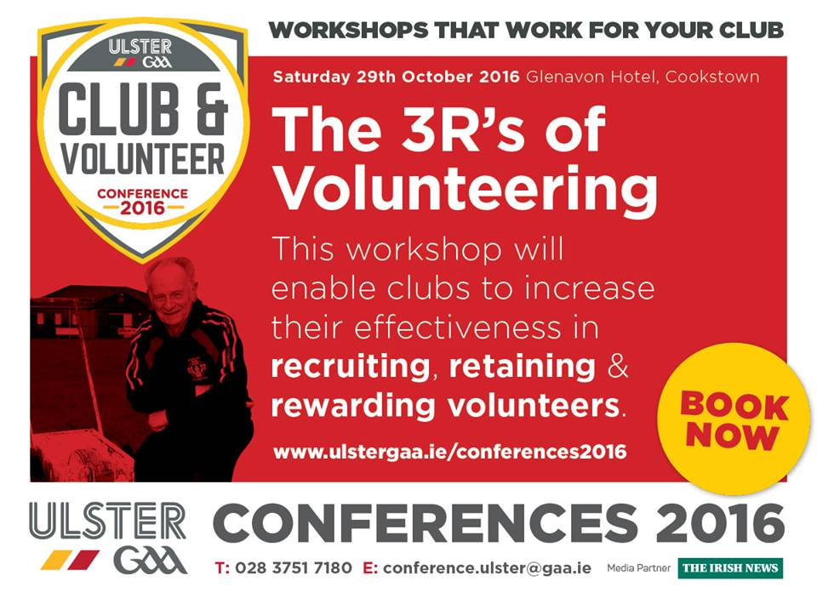
A Club full of Volunteers
St Moninna’s GAC, Killeavy, Co. Armagh

Slide 2
A Club full of Volunteers
George Gillespie
Volunteer Now
St Moninna’s GAC, Killeavy, Co. Armagh

Slide 3
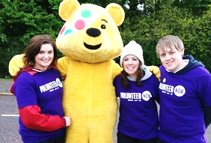
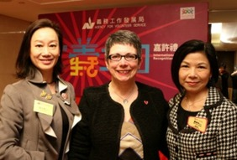
@VNEnterprise @VolunteerNow1
www.facebook.com/VolunteerNow
www.volunteernow.co.uk

Slide 6
The Perfect Fit?

Slide 7
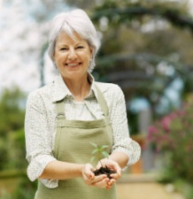
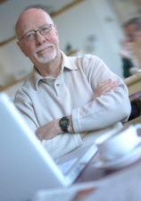
RECRUITMENT PLAN
VOLUNTEER
ORGANISATION
1. Why involve volunteers?
2. What do you want volunteers to do?
3. What qualities/skills do they need to have?
4. How will you find volunteers?
5. How will you select which volunteer you want?
6. How will the volunteer be managed after selection?

Slide 8
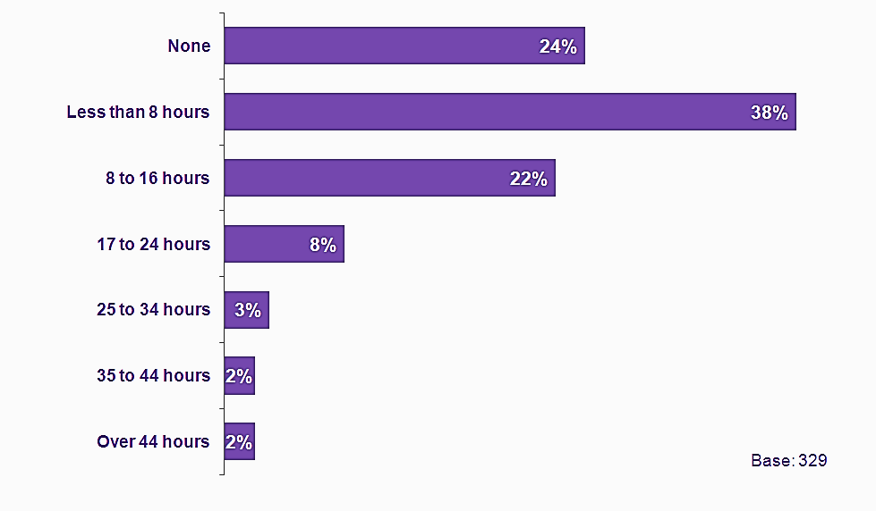
Number of hours in last 4 weeks
Volunteering in Northern Ireland- A Research Report 2016
32% people had volunteered in the last year.
38% Less than 8 hours
24% None
22% 8-16 hours

Slide 9
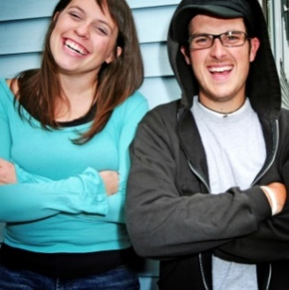
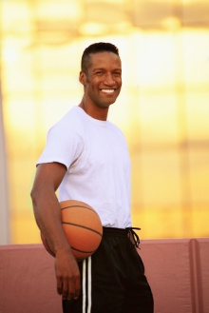
Do the tasks/role…
Make a difference – satisfaction with results
Use existing skills
Gain CV experience/learn new skills/qualification
Personal enjoyment
Meet people/make friends

Slide 10
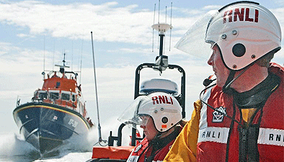
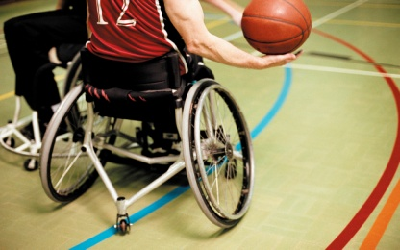
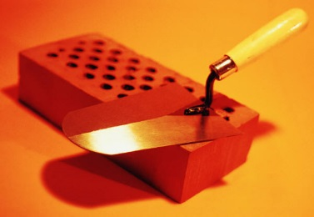
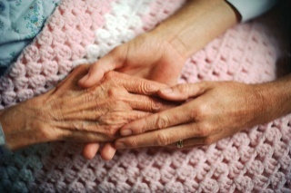
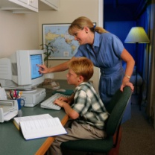
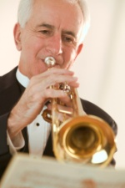
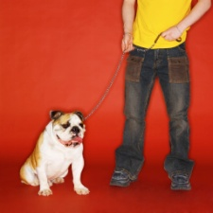
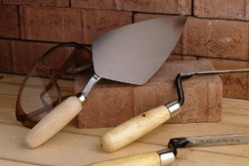
Building a Volunteer Role
Why?
What will the volunteer
be doing?
Where and when will the volunteer
have to carry out the role?
With whom?
What supervision & support will be offered?
What’s in it for the volunteer?
Notes:
WHY?
Challenge the group to avoid defining volunteers’ work only in terms of assisting paid staff. The purpose of everyone’s work – paid staff or volunteer – should be explained in terms of how it contributes to achieving the organisation’s goals. There will be times that the only way to describe the role is via
E.g. To describe the purpose of a volunteer in a youth club as ‘To assist the Youth Worker’ implies that the volunteer is only there to ease the burden on the paid member of staff. This in turn implies that the volunteer only does the tasks that are not interesting or important enough for the Youth Worker, such cleaning up the youth club or looking after the tuck shop.
However, if the volunteer’s purpose is described as something like ‘To supervise activities and support young people’s personal and social development’ it places the volunteer alongside the Youth Worker, both responsible for the club’s success. It tells the volunteer that whatever activities s/he is involved in, s/he should be thinking about how s/he is relating to the young people and providing a good role model for them.
WHAT…?
Consider the key tasks and also difficult aspects of the role.
WHERE AND WHEN…?
Consider if there are minimum hours required, is it set or flexible. Think about the location – where could the role be carried out and not where it is carried out now. Again be flexible.
WITH WHOM?
Is it alone, will the volunteer be working with other volunteers or staff? Is there direct contact with a client group?
SUPPORT AND SUPERVSION..?
Who line manages/supervises the role? How is the volunteer supported? How is work supervised?
WHAT’S IN IT FOR VOLUNTEER?
Identify rewards that the volunteer could get out of the role. Think of altruistic and non altruistic motives.
Explain - ROLE DESCRIPTION
A useful tool to plan and then inform a volunteer about all the above areas is a role/task description
A role/task description outlines everything you and the volunteer need to know about the role, defines and clarifies tasks and duties which the volunteer will be expected to do.

Slide 11
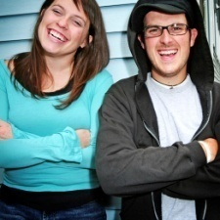
MEETING NEEDS & MOTIVATIONS
Need of organisation,
community or client
Target group
Volunteer
role
description
Potential volunteers
“MESSAGE”
Volunteer roles
Recruitment method
Medium of contact

Slide 12
Volunteer
Policy
Effective Management
Getting off to a good start
Volunteer agreement
Induction
Training
Clear code of practice
Settling in period and review
Keeping the volunteer
Support and Supervision
Continued role related training
Recognition
Procedures for dealing with difficult situations
Closing a volunteer relationship
Exit interview/questionnaires

Slide 13
SUPPORT SUPERVISION
The person
The task
How they carry out tasks
Workload
Training needs
Standards
Outside commitments
Responsibilities
Self esteem/confidence
Sense of value
Having a voice

Slide 14
Individual Reward
Role Satisfaction
Seeing the value of the work
Feeling part of the team
Motivations met
Having a voice

Slide 15
Thank You!
Positive Feedback passed on.
Annual Report
“The success and achievements evidenced in the annual report
are the result of a unique partnership between
children, young people, their carers, funders,
our staff and volunteers.
I want to thank you all for your contribution!”

Slide 16
More information, publications and fact sheets at www.volunteernow.co.uk
34 Shaftesbury Square, Belfast, BT2 7DB
E: enterprise@volunteernow.co.uk
T: 028 9023 2020
Reasonable precautions have been taken to ensure information in this training is accurate. However, it is not intended to be legally comprehensive; it is designed to provide guidance in good faith without accepting liability. If relevant, we therefore recommend you take appropriate professional advice before taking any action on the matters covered herein. Company No. NI620375.
These materials may not be reproduced for any purpose without the express permission of Volunteer Now Enterprises Ltd.

Slide 17
A Club full of Volunteers
Michael O’Neill
Joan Cameron
St Moninna’s Killeavy
Armagh
St Moninna’s GAC, Killeavy, Co. Armagh

Slide 18
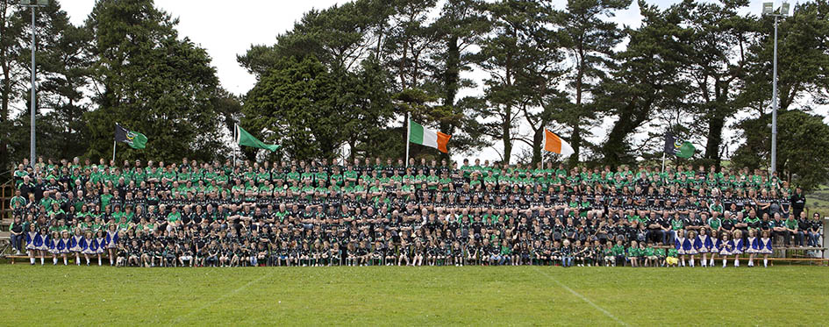
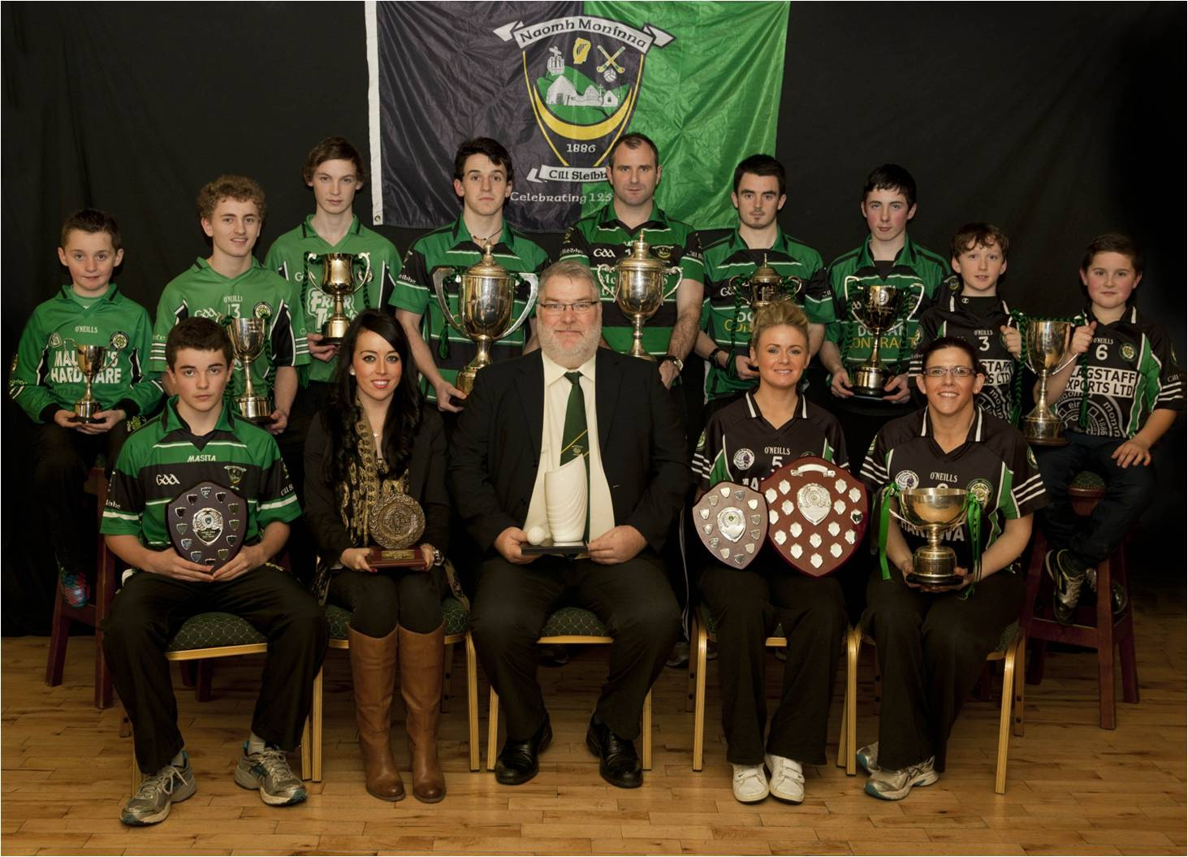
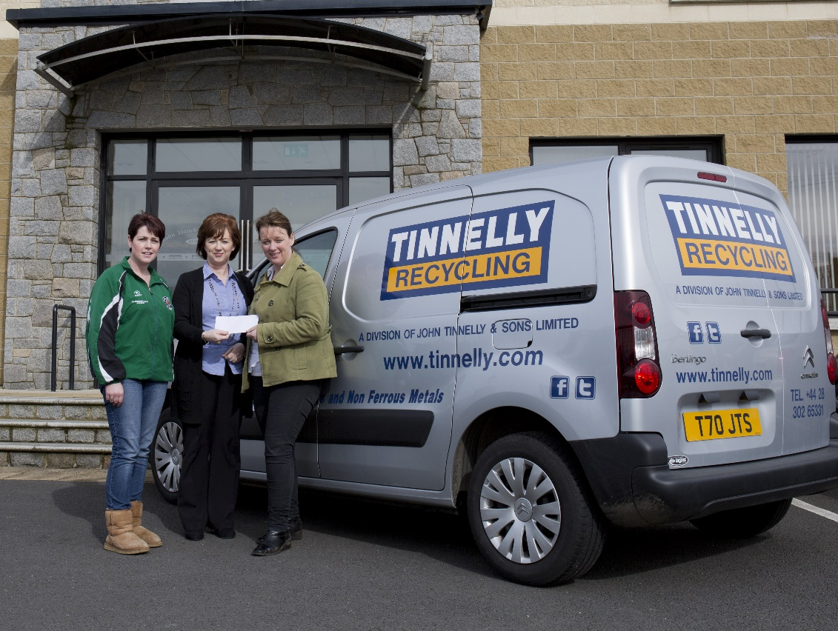
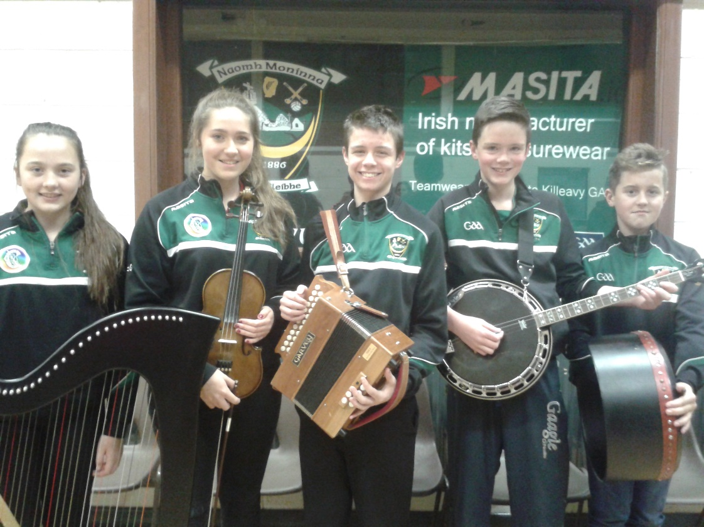
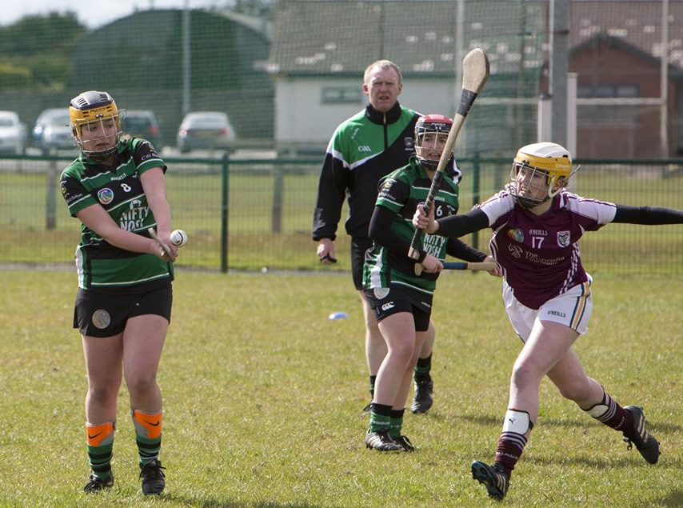
About Killeavy GAC
Founded 1886
South Armagh club bordering on Newry
841 members (514 under 18) – 35 teams
Four playing codes: - football, ladies football, camogie & hurling
Strong in Scór Sinsir and Scór na nÓg
Turnover in the region of £540,000
Gaelic Life Ulster Club of the Year 2013
Club Maith Platinum Award 2016
All Volunteers!
Notes:
Start with a small bit of information on Killeavy, just so that you know where I am coming from.
Killeavy is one of the oldest GAA clubs in Ireland, founded just two years after the GAA itself in 1886
You probably have all driven through Killeavy on the way to Dublin. We lie to the south of Newry, all the way to the border with County Louth, with the Newry Bypass cutting our territory in two
We are a large rural club, currently the third largest in Armagh.
We are one of only a handful of clubs that offer all the main GAA codes – we also have plans to offer handball in the future
We are very prominent in the cultural side of the GAA with our dancers winning the All-Ireland title in 2015
It does take a bit of money to keep us going – never ending fundraising
We had a particularly good year in 2012 - winning 16 county titles and the inaugural Gaelic Life Ulster Club of the Year
We have just been awarded the Platinum level Club Maith award. This process has really been most beneficial in terms of hard wiring our policies and procedures.
This is what we look like – almost 500 got together for this photograph to celebrate our 125th anniversary in 2011.
And getting at last to the purpose of this presentation - we are all volunteers

Slide 19
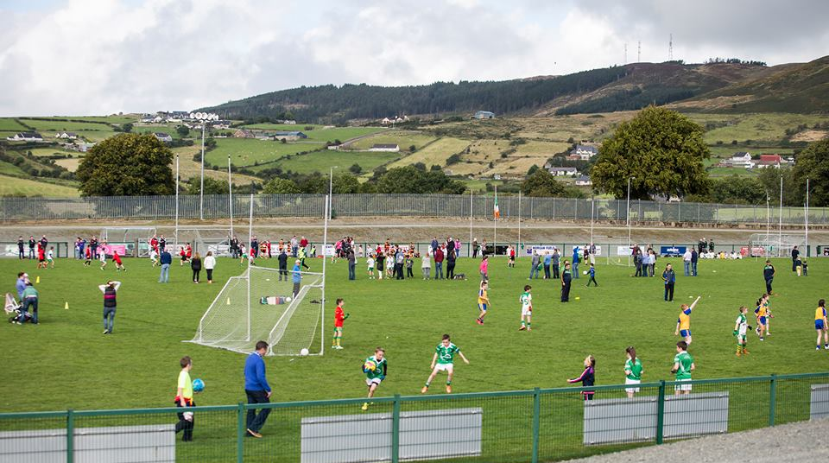
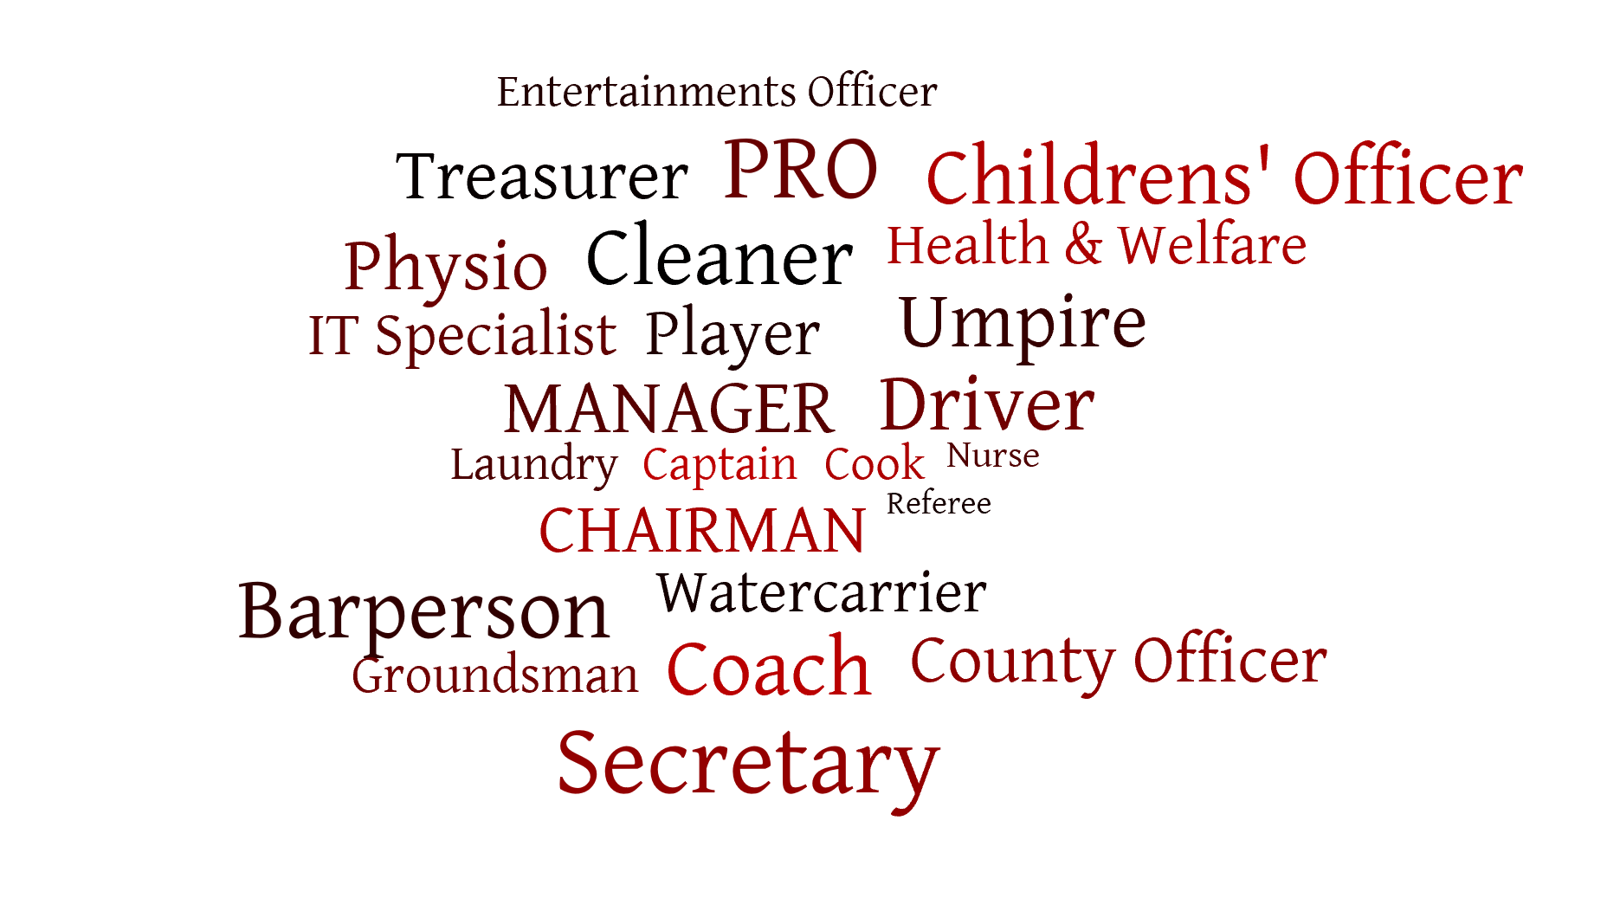
Catching the Volunteer
Ask and keep on asking
Start small, don’t overload
Support, support, support
Recognition
Most people are happy to help
Notes:
This is a fairly typical scene that you could find at our grounds on a number of occasions each week.
For the purposes of our discussion here tonight, the important people are standing in the middle of the field – the fathers, mothers, sisters and brothers of the young people playing the game. This is clearly our greatest source for the volunteer.
We need to get them out of their cars and onto the sidelines. The best way to do this is to ask them.
There are loads of jobs – most do not require any form of skill or knowledge of the rules.
If they are keen to get more involved, support them with training courses, free kit
Thank them – in person, in print, Volunteers night out; with awards Club person of the Year; Hall of Fame.

Slide 20
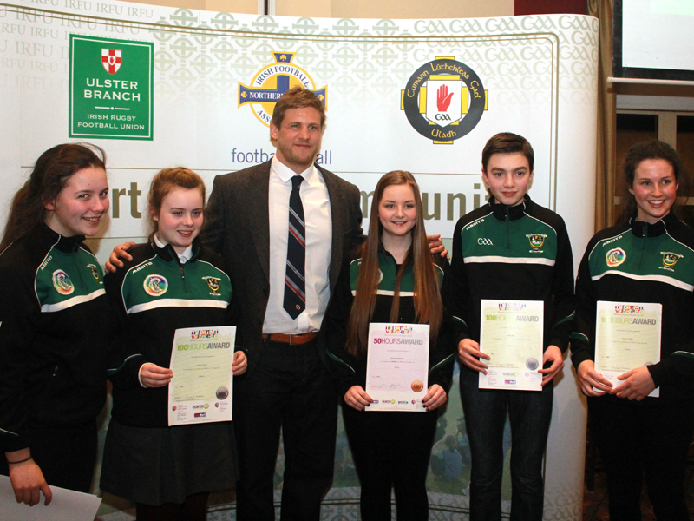
Our Goldmark experience
Killeavy GAC have been involved in the Goldmark Scheme since 2013. We saw it a very valuable way to capture and celebrate the work of our young volunteers around our club. It gave them a focus and something that they could be publicly accredited for in society. It also allowed our young people to be seen as positive role models around the club. To date we have around 80 young people registered to this scheme with 21 having achieved their gold award of 200 hours.
Notes:
Goldmark is a vital part of our strategy to enhance our volunteer capacity. It is providing the club with a motivated, enthusiastic, idealistic and energetic core. Once again, recognition and thanks are the key. At our annual awards evenings, achievements in Goldmark are treated with the same regard as on-field exploits.
Much of what we do, especially around our summer schemes, youth coaching and fundraising would not be possible were it not for our Goldmark volunteers.

Slide 21
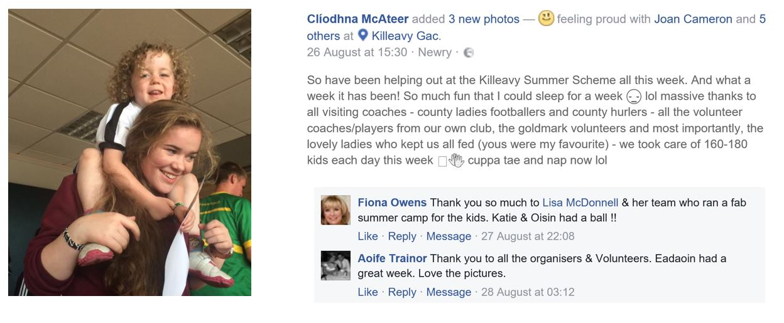
A personal testimony
Notes:
This was posted on the Killeavy facebook site a few days ago following the conclusion of one of the most labour intensive weeks of the year – the Killeavy GAC Summer School.
This young lady is a Goldmark 200 hour award winner and in March of this year, she also took on the committee role of assistant registrar.
Note the feeling of pride. And the messages of thanks. It is hard work but it feels better when it is appreciated.

Slide 22
Volunteering for all ages
Notes:
Two recent award winners from the Killeavy club.
Glen McKeown was named Irish News Young Volunteer of the Year 2015. At 17, Glenn is a referee, coach and administrator for hurling and camogie.
Paddy Mee was given a Ulster GAA President’s Award in 2015 in recognition of a lifetime of service to the GAA – particulary Scór and all things cultural.
Most of our volunteers fall between these age extremes but there is something for all. A vital role is played by a group of fairly senior citizens who give up two hours, once a month, to be part of our Lotto checking rota. Another group of men, players from the 60s and 70s meet up each week for coffee and then take a walk around the grounds picking up litter, carrying our small repairs.
You are never too young or too old to help out.

Slide 23
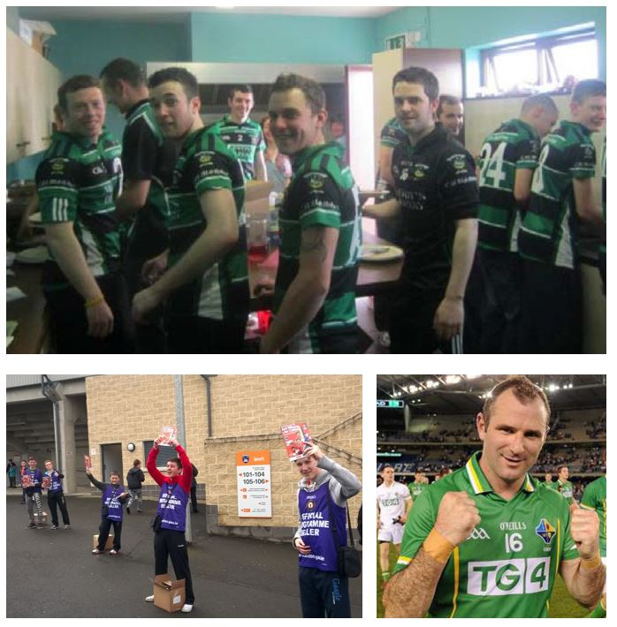
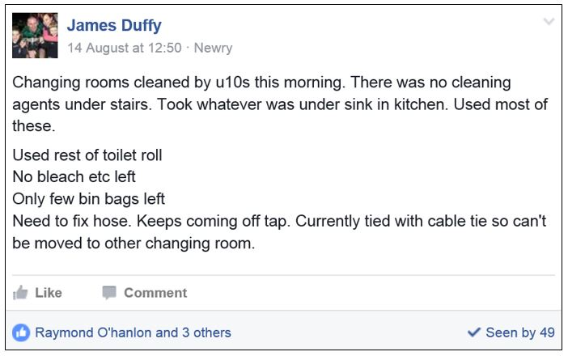
Maintaining an ethos
Notes:
Everybody has to do their bit.
This slide bears witness to the dressing room rota – as you can see we start them early with each team from u10 upwards taking responsibility for one week of cleaning.
Apart from getting the job done – it also teaches responsibility and respect.
Our senior players are absolutely key volunteers – mostly through coaching but here seen cooking up fries for a big breakfast fundraiser.
The next picture shows our u16 footballers raising funds through programme selling at an Armagh game.
The final picture is Killeavy’s most famous son – Steven McDonnell who has won almost everything in our game. I remember reading an article in the Sunday Times about 10/12 years ago. It was one of those lifestyle things where they ask you for your favourite film, favourite food, etc. Steven was also asked who had the most influence of his career and he named Thomas Mallon who was his first football coach in Killeavy. He said that Tom taught him not only game skills but personal skills such as respect, judgement and reliability. Thirty years on, Steven is now manager of the club’s senior footballers while his wife coaches the u14 girls and maintains our facebook page.

Slide 24
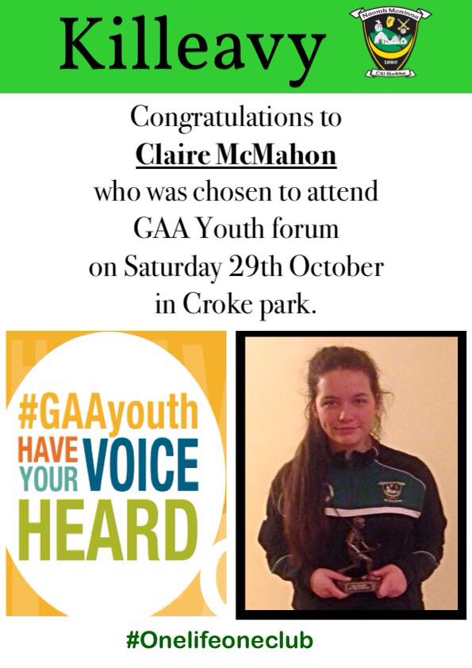
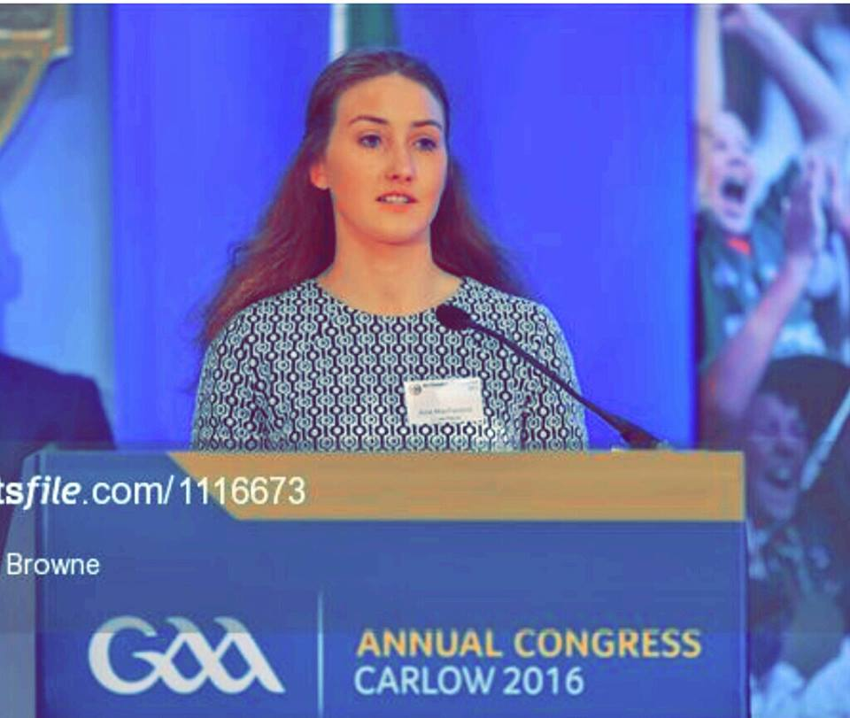
Give them a challenge
Notes:
Two of our young members, both products of the GoldMark scheme – Aine McParland becoming the first Killeavy member to address the Annual GAA Congress and Claire McMahon – attending the GAA Youth Forum today.

Slide 25
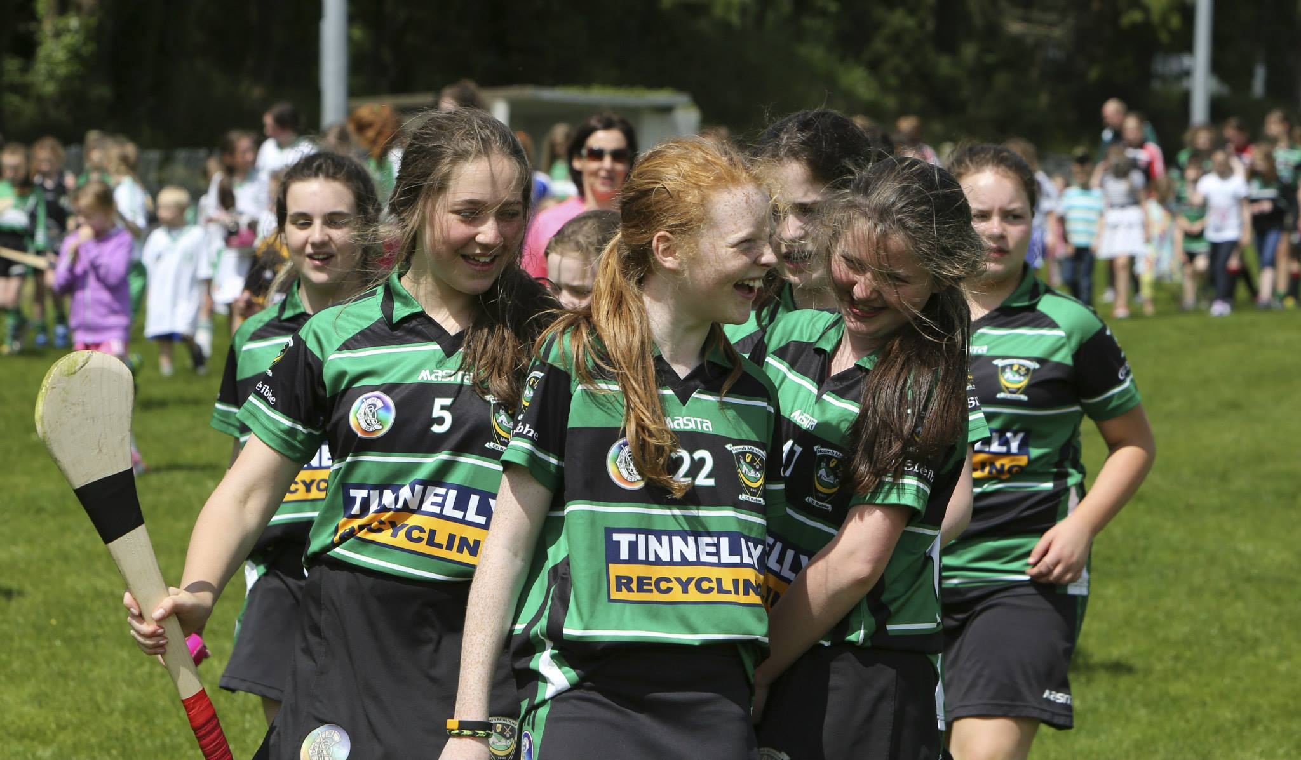
Keeping it fresh
7.6 No person will be eligible to serve as Chairman of the Executive Committee for more than three years in any period of four consecutive years.
7.7 No person will be eligible to serve as Secretary or Treasurer of the Executive Committee for more than five years in any period of six consecutive years.
Notes:
Too many clubs stagnate as one person or a small group of people get themselves into positions of authority year after year.
These two clauses are taken from our club constitution and are key to our overall volunteer strategy.
Firstly, people will take on key roles if they know there is an exit strategy – that they won’t be bogged down for years.
Second – this avoids burnout allowing individuals to make heavy commitments over a short time.
Third – it avoids the appearance of cliques or the feeling that one person is bigger than the club.
Finally – it continually brings new people into the fold and moves things on from one generation to the next.
Fixed terms – an absolute joy.

Slide 26
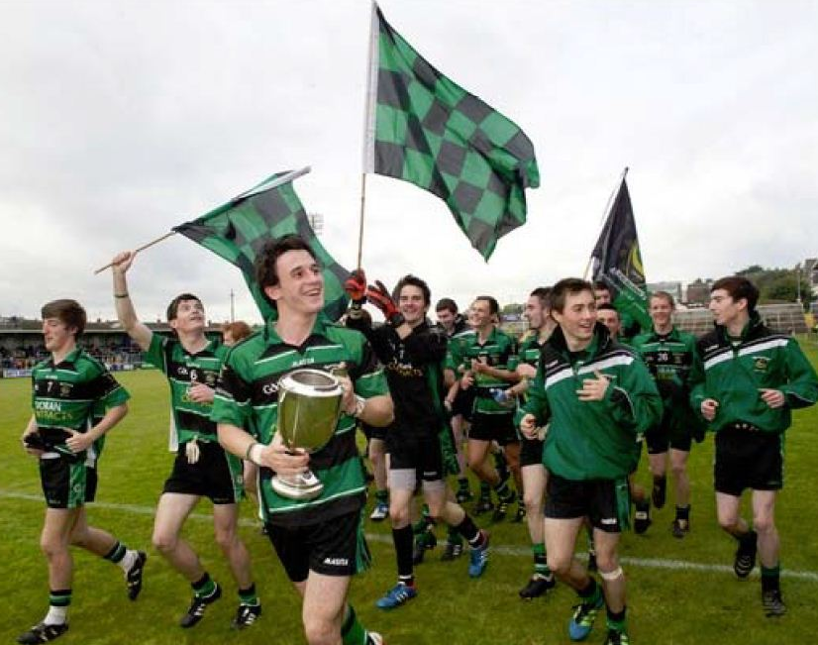
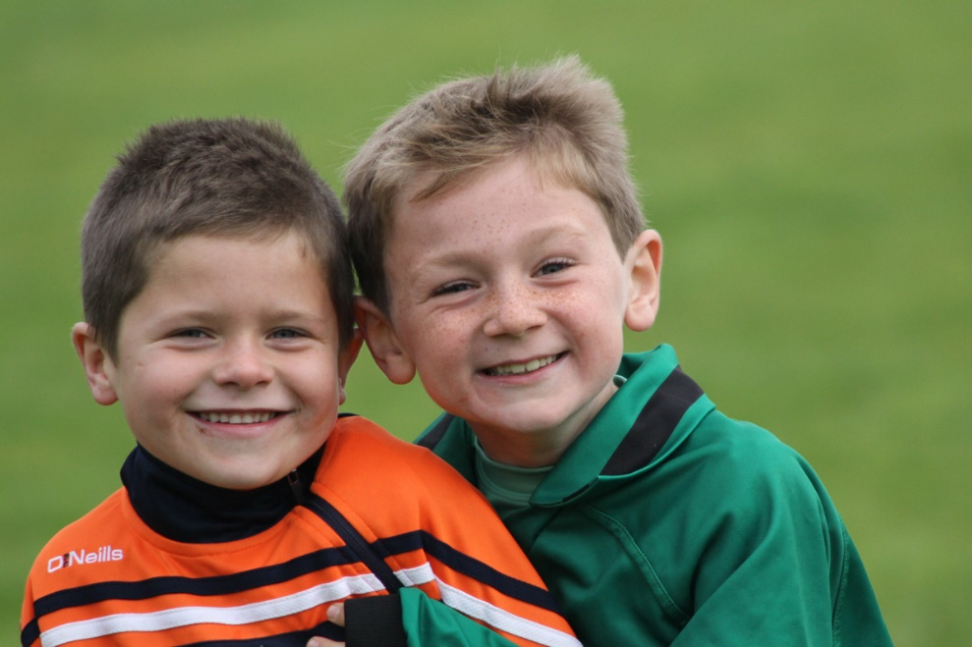
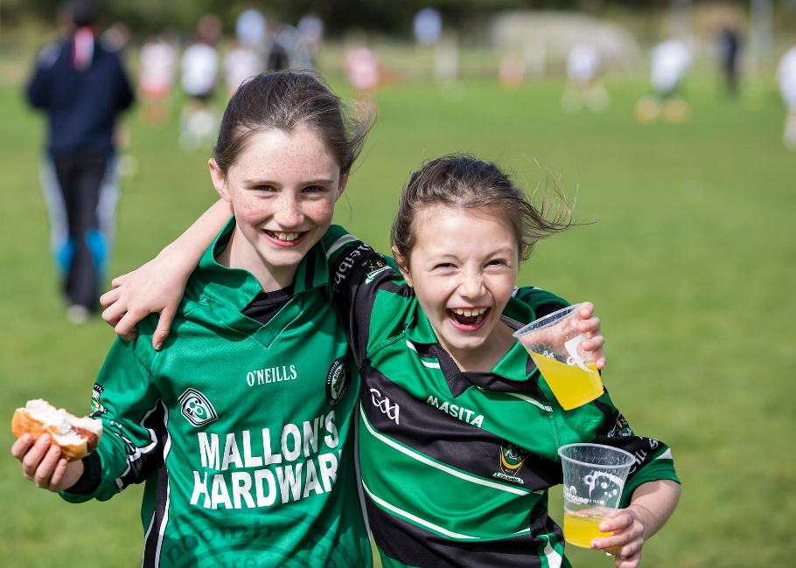
Why volunteer?
https://www.youtube.com/watch?v=NwwUVvMNDys
Notes:
A personal anecdote to finish.
I will always remember a glorious summer’s evening around 12/13 years ago. Things were not going well in the club. We had elected a very powerful individual as chairman, a multimillionaire in his own successful business, who was used to instant obedience from his workforce. While we hoped to gain from his business acumen, not to mention his money, his lack of sympathy for the role of the volunteer was in danger of splitting the club in two.
I was driving up the road prior to what I knew was going to be a particularly fractious and argumentative meeting of the executive committee and wondering to myself why I was putting myself through this – why not just walk away.
As I said, it was a glorious evening and when I drove through the gates of the club there must have been about 150 people across our two pitches. Camogs in one corner, hurlers in another, a senior game going on watched by a bumper crowd.. Kids playing games all over the place. It was then that I realised that this was about more than a club – it was about a community. I was not simply volunteering in a committee – I was supporting my community and in so doing I was helping to generate photographs similar to the ones I have chosen here.
If I have time, I would like to take just two minutes to show a video which I think sums up this feeling of support for one’s community. You will recall the big picture from earlier – this video is the record of a special day

